Slide 1

CSE3251
Computer Networks
Dr. Asif Zaman
Professor, CSE, RU
March 2024

Slide 2

Text Books
Lesson Plan
Text book
Resources
Slides
Lab materials
https://tinyurl.com/asifzaman3180-lec

Slide 3
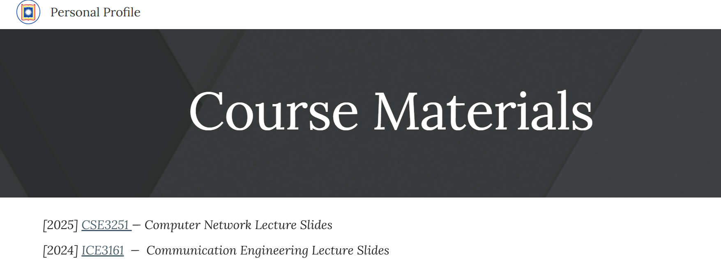

Slide 4
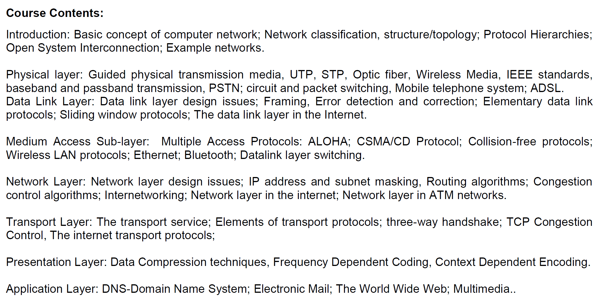

Slide 5
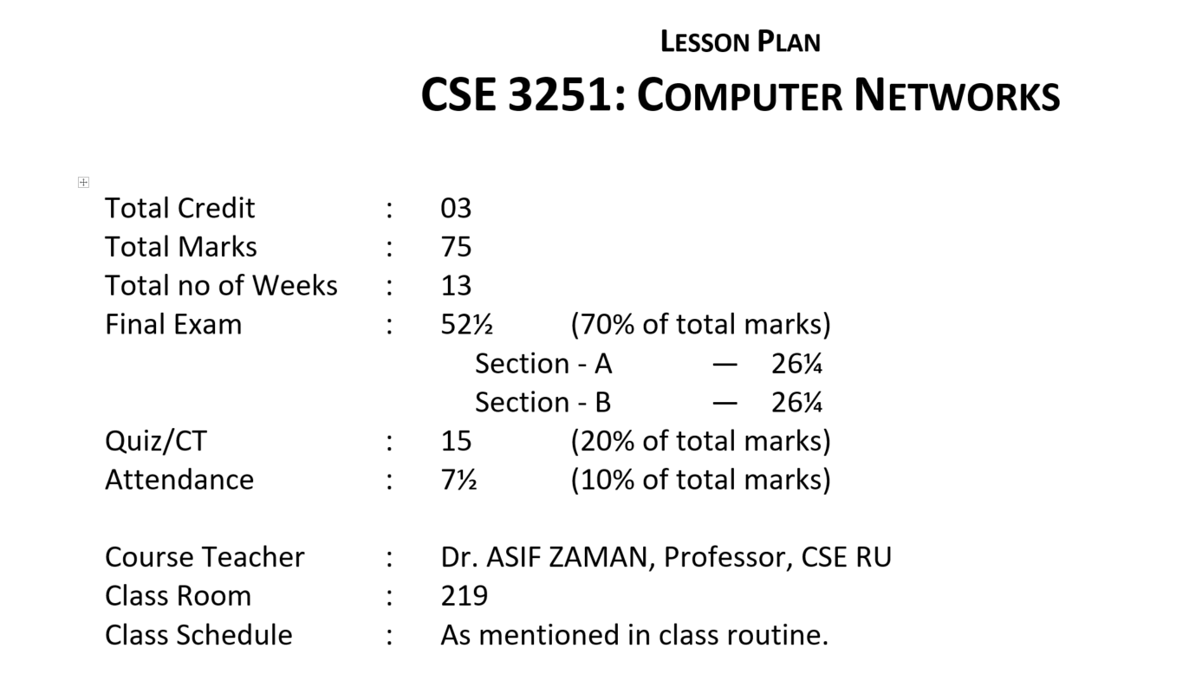
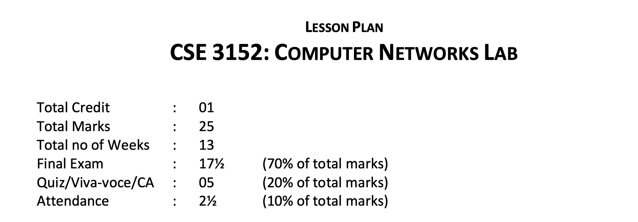

Slide 6
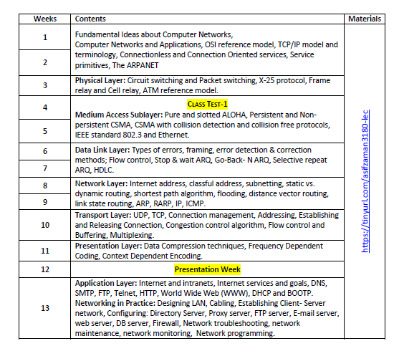

Slide 7
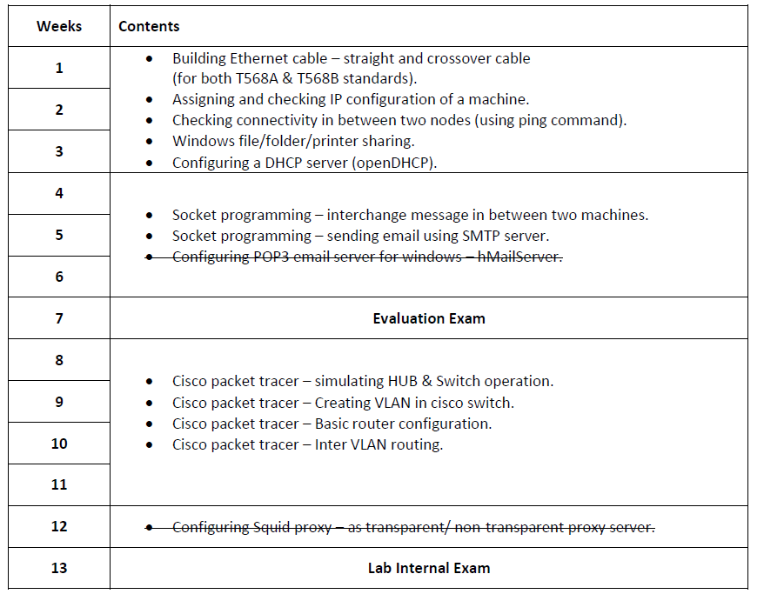

Slide 8
Communication Engineering
Device 1
Device 2

Slide 9
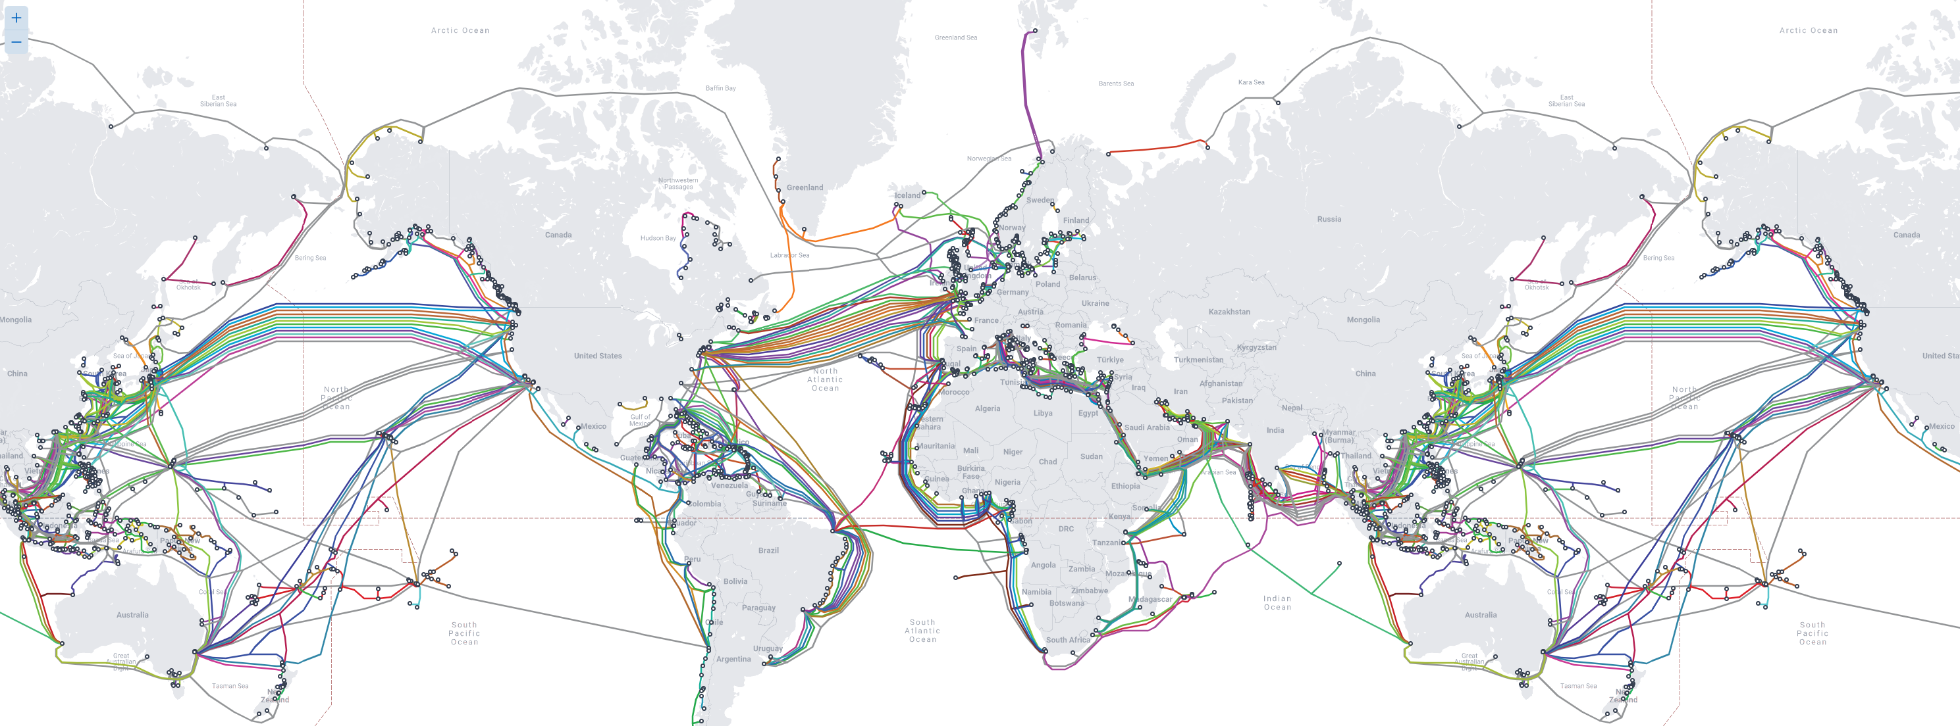

Slide 10
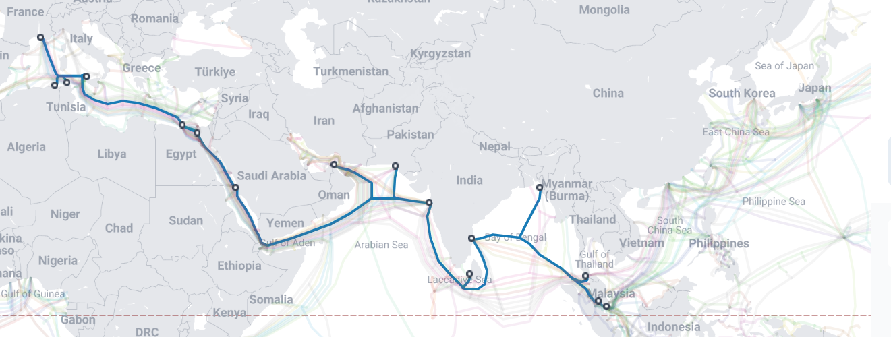
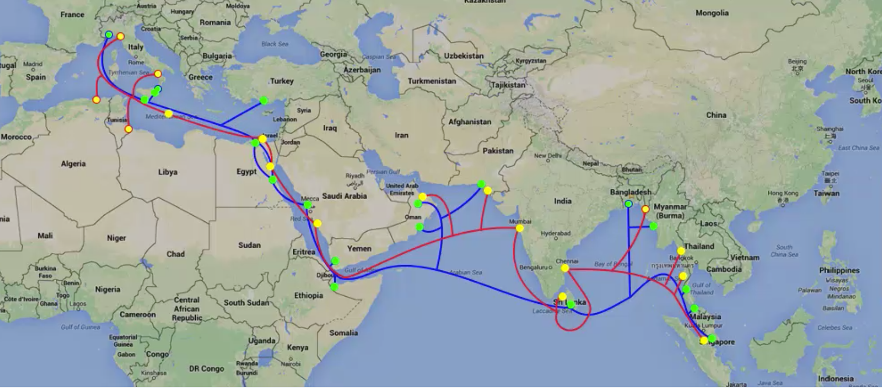
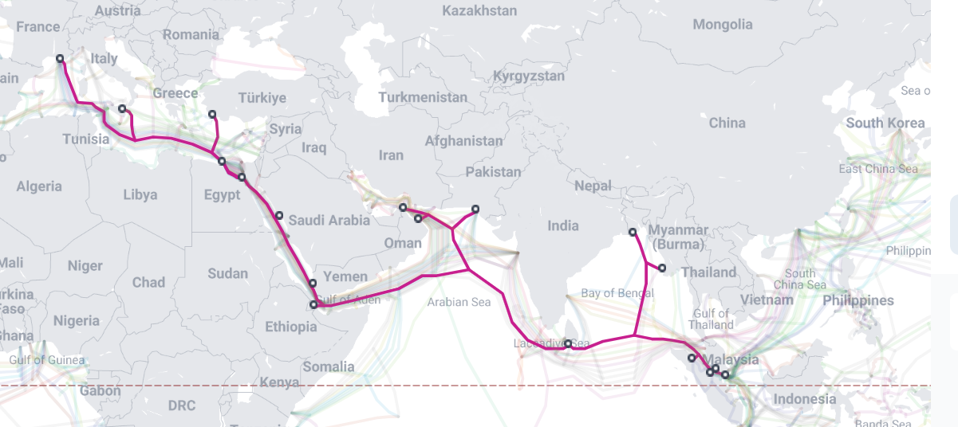
South East Asia–Middle East–Western Europe 4/5 (SEA-ME-WE 4/5)

Slide 11
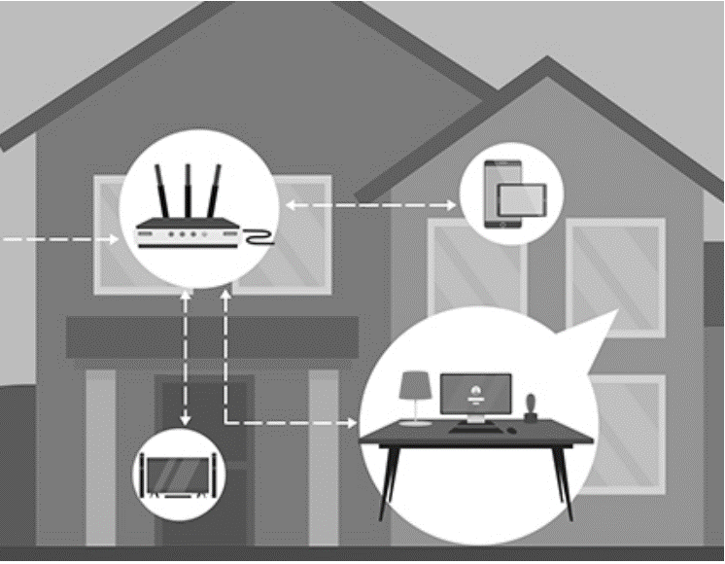
International Internet Gateways (IIGs) (34)
Local ISP
National ISP (124)
National Internet Exchanges (NIXs) (11)

Slide 12
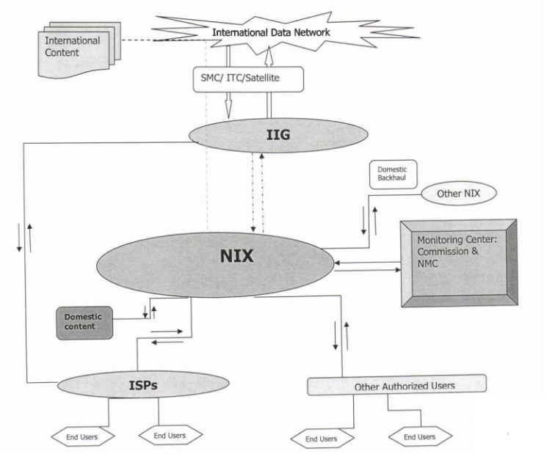

Slide 13
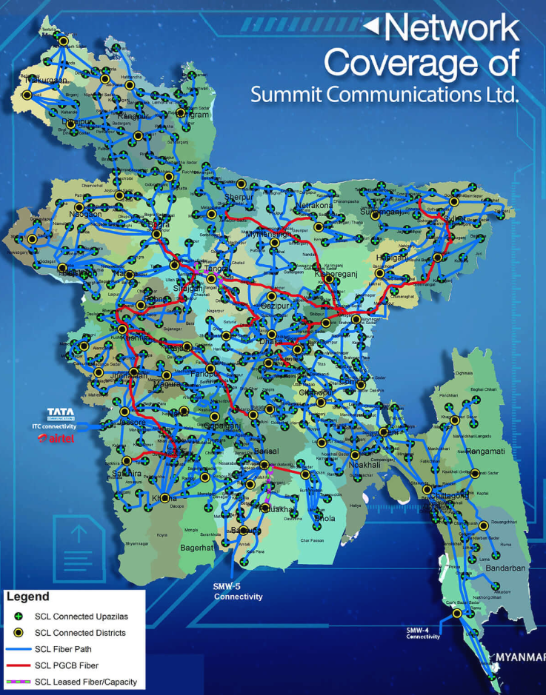

Slide 14
Fundamental Idea
Network Card (LAN Card)
Network Card (LAN Card)

Slide 15
Fundamental Idea
HUB/ SWITCH
Protocol

Slide 16
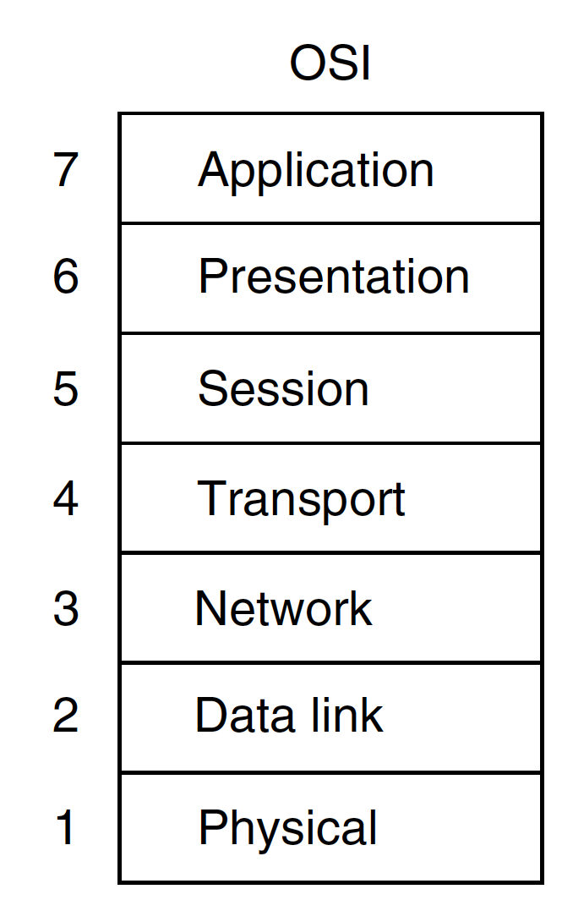
Introduction
All People Seem To Need Data Processing
Open Systems Interconnection
International Organization for Standardization(ISO)

Slide 17
RJ-45 Connector
UTP –Unshielded Twisted Pair

Slide 18
Lab Work

